Slide 1
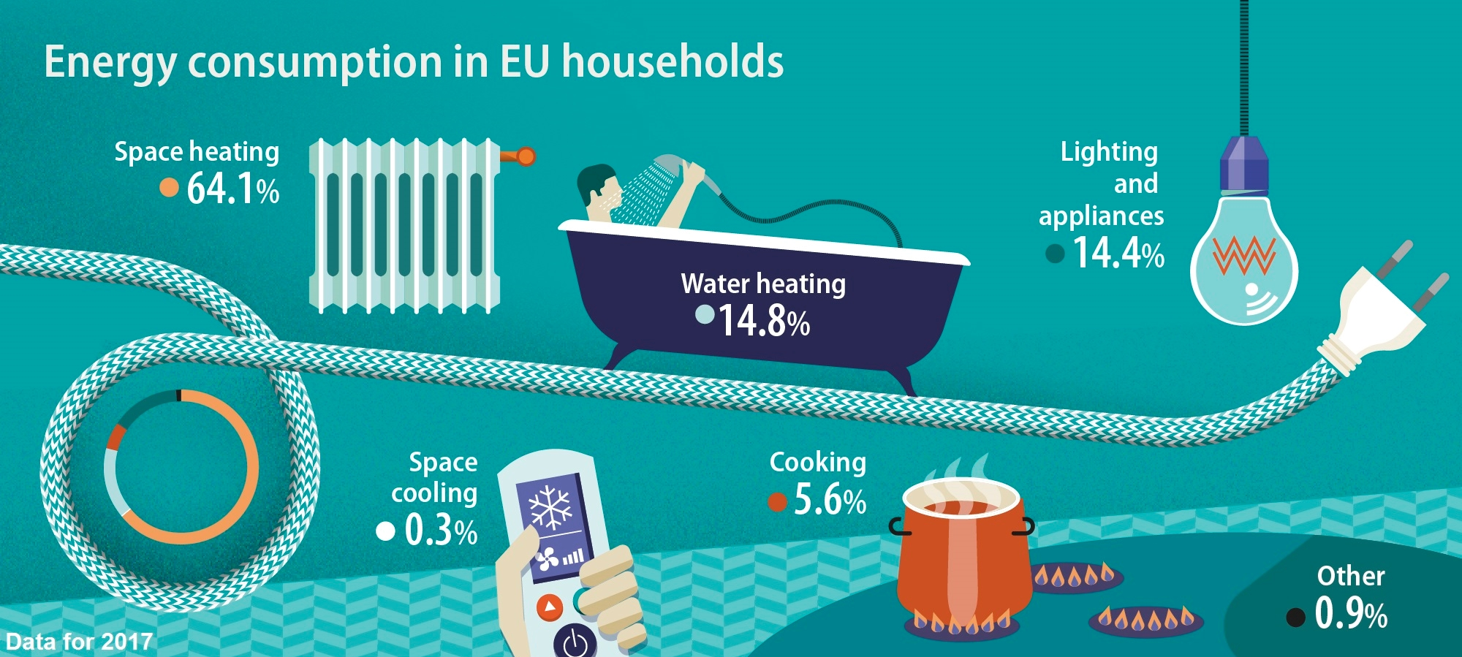
Household Electric Power Consumption A Time-Series Forecasting Project
By –
Suryam Gupta

Slide 2
About the Dataset
Source – UCI Machine Learning Repository dataset
Measurements of electric power consumption in one household with one-minute sampling rate over a period of almost 4 years (2006-2010)
Dataset characteristics – Multivariate, Time-Series Analysis
Shape - (2075259, 9)
Different electrical quantities and some sub-metering values are available: date, time, global_active_power, global_reactive_power, voltage, global_intensity, sub_metering_1, sub_metering_2, sub_metering_3
Presence of null values

Slide 3
Data Mining and Visualizations
Dataset indexed by date and time
‘?’ replaced with NaN and these null values filled with mean of each column
Data Summary – shape, info(), describe()
Various charts resampled over different time intervals were plotted, few are –
i. All features against datetime resampled by month
ii. Line graph of data resample over month, day and hours by mean
iii. Histogram plot of data resampled over month by mean
Correlation matrix using Pearson and Spearman method
Inferences – i. Global_intensity and Global_active_power are highly correlated.
ii. Voltage and Global_active_power are less correlated.

Slide 4
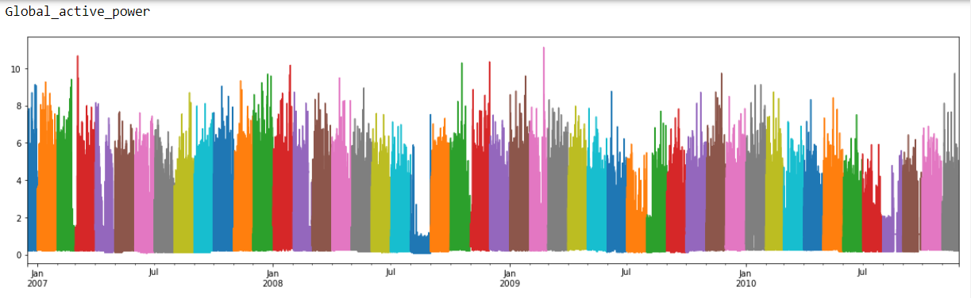
Some inferences:
i. The household consumed extremely less power in August 2008
ii. The power usage is frequently more in the last days of the month
iii. Voltage seems to be constant throughout
iv. Sub_meterting_3 is always more compared to the other submetering values as it is the
power consumed by ACs and Electric Heaters
v. Changing the periodicity (month, day, hour, etc.) largely affects the interaction of data
with a model

Slide 5
Data Preparation and Forecasting
Data resampled over hours for reducing computation time and better efficiency
Function to convert series to supervised learning
Normalize features using MinMaxScaler() to get values in range (0,1)
Splitting into training and testing data (train 1 year of data and predict next 3 years)
Reshaping input to 3D (samples, timesteps, features) as required by the NN model
Applying Long Short Term Memory (LSTM) – An artificial Recurrent Neural Network (RNN) architecture for forecasting our training data, with following characteristics:
100 neurons in the first layer, Dropout = 20%, 1 neuron in the output layer predicting the Global_active_power, using Mean Absolute Error (MAE) loss function and for optimizer, the efficient Adam version of Mini Batch Stochastic Gradient Descent while compiling, fitting the model for 20 training epochs with a batch size of 70

Slide 6
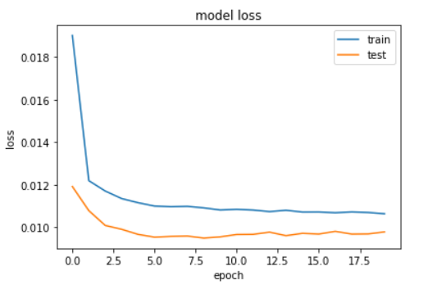
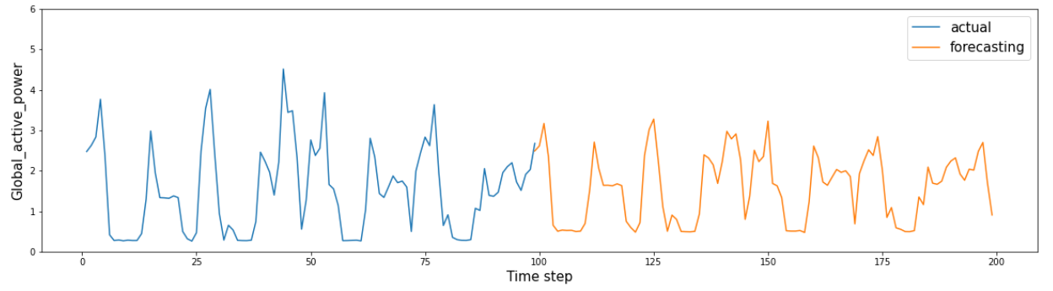

Slide 7
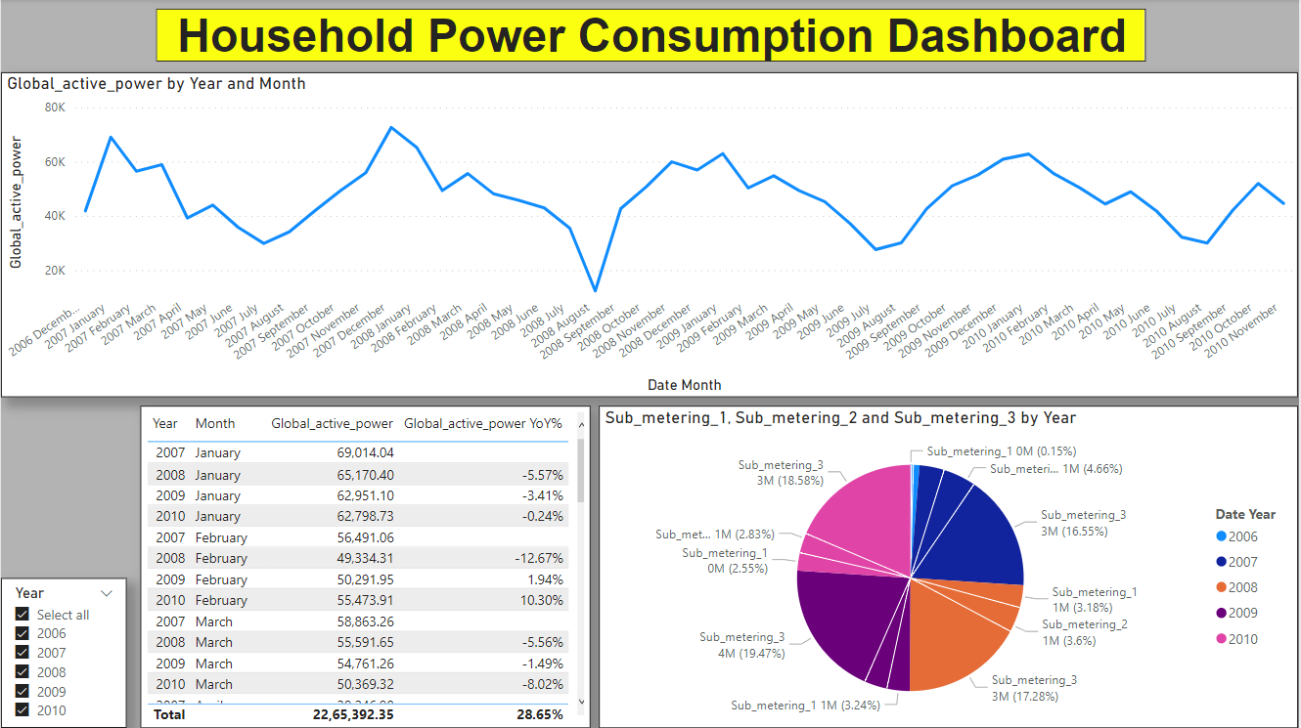
Dashboard (Power BI)

Slide 8
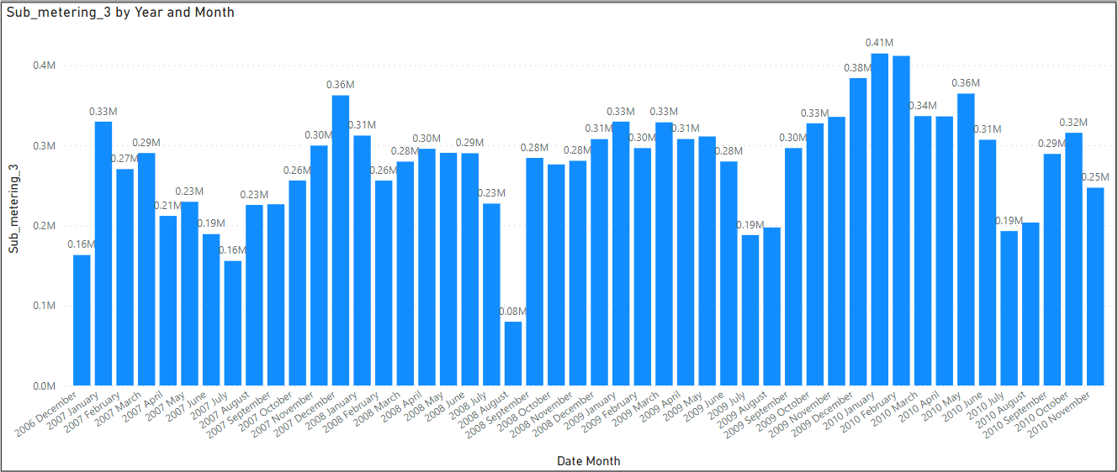
A pattern or seasonality can be noticed –
Every year, sub_metering_3, i.e. the power consumption by ACs and Electric Heaters, has the highest value at around January, which then keeps on decreasing until July. After its lowest value in July, it again starts increasing till January and the cycle continues.
Inference –
July to Jan are the spring and winter seasons, when usage of both electric heaters and AC is high (ACs can also be used to keep the room warm). On the other hand, Jan to July is the summer season, where comparatively, electric heaters won't be used much and only AC, resulting in a gradual decrease in value.

